Slide 1

HI5030 Business Systems Analysis and Design
Tutorial Week 04
How can Data Flow Diagrams (DFDs) be used to improve business processes in a Sydney-based logistics company?
DFDs can visually map out the entire logistics process, from order placement to delivery, identifying inefficiencies and bottlenecks. For instance, a DFD can highlight how data about shipments moves between various departments, revealing potential delays or areas where automation could reduce manual work. In Sydney’s competitive logistics market, using DFDs can streamline operations, reduce costs, and improve customer satisfaction.
08
Work in small groups to create a Level 0 DFD for a hypothetical logistics company in Sydney. Then, discuss how your DFDs could be refined to improve the company's operations.

Slide 2
Inventory Management
08
Customer
Order Processing
Warehouse
Billing
Shipping
This DFD includes the main components of the company’s operations such as Customer, Order Processing, Inventory Management, Warehouse, Shipping, and Billing. The arrows represent the flow of data between these components, indicating how an order moves from the customer through the system until it is shipped and billed.
It effectively represents a Level 0 Data Flow Diagram (DFD) for a hypothetical logistics company in Sydney, covering key processes such as Customer, Order Processing, Inventory Management, Warehouse, Shipping, and Billing. The arrows clearly show the flow of information between these components, which aligns well with the discussion on how DFDs can be used to improve business processes by identifying inefficiencies, potential delays, and opportunities for automation.

Slide 3
HI5030 Business Systems Analysis and Design
Tutorial Week 04
1. Discuss how the system development process changed from the traditional waterfall model to the newer adaptive software development methodologies.
The system development process has undergone significant changes from the traditional Waterfall model to the newer adaptive software development methodologies, reflecting the evolving needs of software development in response to rapid technological advancements, changing market demands, and the need for greater flexibility and efficiency.
1. Traditional Waterfall Model
The Waterfall model, introduced in the 1970s, is a linear and sequential approach to software development. It follows a structured flow where each phase must be completed before the next one begins. The typical phases include:
Requirement Analysis: Gathering and documenting requirements.
System Design: Creating the architecture and design specifications.
Implementation: Writing the actual code based on the design.
Testing: Verifying that the system meets the requirements.
Deployment: Delivering the system to the end-users.
Maintenance: Ongoing support and updates.
08

Slide 4
HI5030 Business Systems Analysis and Design
Tutorial Week 04
1. Discuss how the system development process changed from the traditional waterfall model to the newer adaptive software development methodologies.
Key Characteristics:
Linear Process: Each phase must be completed before moving on to the next.
Document-Driven: Extensive documentation is created at each phase.
Little Flexibility: Changes in requirements or design after a phase is completed are difficult and costly to implement.
Predictable and Controlled: Emphasizes upfront planning and clear milestones.
Challenges of the Waterfall Model:
Inflexibility: Once a phase is completed, it's challenging to go back and make changes.
Late Testing: Testing occurs after implementation, which can lead to the discovery of major issues late in the process.
Requirement Uncertainty: Assumes that all requirements are known upfront, which is often not the case.
Customer Feedback: Limited involvement of customers during development, leading to potential misalignment with their needs.
08

Slide 5
HI5030 Business Systems Analysis and Design
Tutorial Week 04
2. Shift to Adaptive Software Development Methodologies
The limitations of the Waterfall model, especially its inflexibility and lack of responsiveness to change, led to the development of adaptive software development methodologies. These methodologies are designed to be more flexible, iterative, and customer-focused. Key adaptive methodologies include Agile, Scrum, Extreme Programming (XP), and Lean Software Development.
Key Changes in the Development Process:
1. Iterative and Incremental Development:
Adaptive methodologies embrace an iterative process where development is divided into small, manageable iterations or sprints, typically lasting 2-4 weeks.
Each iteration involves a complete cycle of development, including planning, design, coding, testing, and deployment, delivering a potentially shippable product increment.
2. Customer Collaboration:
Unlike the Waterfall model, where customer involvement is limited to the beginning and end of the project, adaptive methodologies involve continuous collaboration with customers throughout the development process.
Regular feedback from customers ensures that the product evolves in line with their needs and expectations.
3. Emphasis on Flexibility:
Adaptive methodologies prioritize flexibility and responsiveness to change. Requirements are expected to evolve, and the development process is designed to accommodate changes at any stage.
This flexibility allows teams to pivot and adjust the project direction based on feedback, market shifts, or new information.
08

Slide 6
HI5030 Business Systems Analysis and Design
Tutorial Week 04
4. Continuous Testing and Integration:
Testing is integrated into every iteration, ensuring that issues are identified and resolved early in the development process.
Continuous integration practices ensure that code is regularly merged and tested, reducing the risk of integration problems late in the project.
5. Minimal Documentation:
While documentation is still important, adaptive methodologies often emphasize "just enough" documentation, focusing more on working software over comprehensive documentation.
The focus is on delivering value quickly and efficiently, rather than getting bogged down in excessive documentation.
6. Self-Organizing Teams:
Teams in adaptive methodologies are typically cross-functional and self-organizing, meaning they have the autonomy to make decisions and manage their own work.
This structure fosters creativity, accountability, and faster decision-making.
7. Focus on Value and Quality:
Adaptive methodologies emphasize delivering the highest value features first, ensuring that the most critical aspects of the project are completed early.
There is also a strong emphasis on quality, with practices like test-driven development (TDD), pair programming, and code reviews being common.
08

Slide 7
HI5030 Business Systems Analysis and Design
Tutorial Week 04
3. Benefits of Adaptive Methodologies
Improved Flexibility: Ability to adapt to changing requirements and market conditions.
Faster Delivery: Incremental delivery of working software allows for faster time-to-market.
Higher Customer Satisfaction: Continuous customer involvement ensures the product meets their needs.
Reduced Risk: Continuous testing and integration reduce the risk of major issues.
Enhanced Team Collaboration: Self-organizing teams and regular communication foster collaboration and innovation.
4. Conclusion
The transition from the traditional Waterfall model to adaptive software development methodologies represents a fundamental shift in how software is developed. The Waterfall model's rigid, linear approach has been largely replaced by more flexible, iterative, and customer-centric methodologies. These adaptive methodologies, such as Agile and Scrum, are better suited to the dynamic nature of modern software development, allowing teams to deliver high-quality software that meets customer needs in a timely and efficient manner.
08

Slide 8
HI5030 Business Systems Analysis and Design
Tutorial Week 04
2. Critically argue how prototyping would benefit an Agile-based software development.
Prototyping can significantly benefit Agile-based software development, enhancing its principles of adaptability, customer collaboration, and iterative progress. However, it's also essential to critically examine how and when prototyping should be used within Agile to maximize these benefits and avoid potential pitfalls.
Benefits of Prototyping in Agile-Based Development
Enhancing Customer Collaboration and Feedback:
Visualization of Requirements: Agile emphasizes continuous collaboration with the customer. Prototyping provides a tangible way to visualize requirements early in the development process, making it easier for customers to understand and give feedback on the evolving product.
Early Validation: A prototype allows stakeholders to see a working model of the system early in the process, helping them validate whether the development is on the right track. This can lead to early detection of misunderstandings or misalignments between customer expectations and the development team’s understanding.
Iterative Refinement: As prototypes evolve, customers can refine their requirements, providing feedback that guides the next iteration. This aligns perfectly with Agile’s iterative cycles, ensuring that the product continuously evolves based on real user input.
08

Slide 9
HI5030 Business Systems Analysis and Design
Tutorial Week 04
2. Critically argue how prototyping would benefit an Agile-based software development.
2. Reducing Risk and Uncertainty:
Exploration of Ideas: Prototyping allows teams to explore multiple design options and technical solutions with minimal investment of time and resources. This exploration helps mitigate risks associated with making wrong design or technology choices.
Early Identification of Issues: By building prototypes, teams can identify potential technical challenges, usability issues, or feature gaps early in the development process. This proactive approach reduces the likelihood of costly changes later in the project.
3. Improving Communication Within the Team:
Alignment of Understanding: Prototypes serve as a common reference point for both technical and non-technical team members, facilitating better communication and alignment of understanding. This is particularly useful in Agile teams, which often consist of cross-functional members.
Clarification of User Stories: In Agile, user stories describe desired functionalities from the user's perspective. Prototypes can make these stories more concrete, helping the team better understand the user’s needs and how to implement them effectively.
08

Slide 10
HI5030 Business Systems Analysis and Design
Tutorial Week 04
2. Critically argue how prototyping would benefit an Agile-based software development.
4. Supporting Incremental Development:
Building Incrementally: Agile methodologies encourage the incremental delivery of software. Prototyping fits well within this approach, allowing teams to build, test, and refine small parts of the system before integrating them into the broader architecture.
Progressive Enhancement: Prototypes can start as simple mockups or wireframes and progressively evolve into fully functional components. This gradual enhancement ensures that the product grows in complexity in line with the team’s understanding and the customer’s feedback.
5. Facilitating Better Design Decisions:
User-Centered Design: Prototyping encourages user-centered design, as the focus shifts from abstract requirements to concrete user interactions. This helps Agile teams make informed design decisions that prioritize usability and user experience.
Flexibility in Design: Agile’s emphasis on flexibility is complemented by prototyping, as it allows design decisions to be revisited and revised with each iteration. This flexibility ensures that the final product is well-aligned with user needs and expectations.
08

Slide 11
HI5030 Business Systems Analysis and Design
Tutorial Week 04
2. Critically argue how prototyping would benefit an Agile-based software development.
Critical Considerations and Potential Challenges
Over-Reliance on Prototyping:
Prototype as a Crutch: There is a risk that teams may become over-reliant on prototypes, using them as a crutch rather than fully developing the product. If not managed carefully, this could lead to delays or even a lack of progress in building the actual system.
Prototype vs. Final Product: A prototype is often a simplified version of the final product, and there’s a danger that stakeholders may misunderstand its purpose. They might mistakenly assume that the prototype represents the final product’s speed, performance, or usability, leading to unrealistic expectations.
Resource and Time Constraints:
Time-Consuming Process: While prototyping can save time in the long run, it can be time-consuming, especially if multiple iterations are needed. In Agile, where time-boxed sprints are critical, excessive focus on prototyping could detract from the actual development work.
Resource Allocation: Prototyping requires resources, both in terms of tools and skilled personnel. In some Agile projects, particularly those with tight budgets or small teams, dedicating these resources to prototyping might not always be feasible or justifiable.
08

Slide 12
HI5030 Business Systems Analysis and Design
Tutorial Week 04
2. Critically argue how prototyping would benefit an Agile-based software development.
3. Scope Creep and Feature Creep:
Expansion of Scope: As prototypes evolve, there’s a risk of scope creep, where additional features or requirements are continuously added based on stakeholder feedback. While Agile is flexible, uncontrolled scope expansion can lead to project delays or an unfocused product.
Unclear Boundaries: Agile teams need to set clear boundaries regarding what the prototype will cover. Without these boundaries, the prototype could expand in complexity, leading to more iterations than initially planned and potentially derailing the project timeline.
4. alancing Prototype and Production Code:
Transition from Prototype to Product: In Agile, there’s often a need to balance the prototype with the development of production-ready code. If the prototype is too detailed or complex, it can be challenging to transition to production code without significant rework.
Technical Debt: Prototypes are usually not optimized for performance or scalability. If a prototype evolves directly into the final product without adequate refactoring, it could introduce technical debt, which might compromise the quality and maintainability of the final system.
08

Slide 13
HI5030 Business Systems Analysis and Design
Tutorial Week 04
2. Critically argue how prototyping would benefit an Agile-based software development.
Conclusion
Prototyping can be a powerful tool in Agile-based software development, offering significant benefits in terms of customer collaboration, risk reduction, and iterative refinement. However, it is essential to use prototyping judiciously and with a clear understanding of its purpose. Agile teams must balance the benefits of prototyping with the need to deliver working software incrementally and efficiently. By setting clear goals, managing stakeholder expectations, and ensuring that prototyping efforts do not overshadow actual development work, Agile teams can leverage prototypes to build better, more user-centered products while staying true to Agile principles.
08

Slide 14
HI5030 Business Systems Analysis and Design
Tutorial Week 04
3. Compare and contrast the following methodologies elaborating on the most suited scenarios they could be applied:
a) UP
b) Xp
c) SCRUM
d) KAMBAN
e) LEAN
08
a) Unified Process (UP)
Description:
UP (Unified Process) is a framework for iterative software development that emphasizes an architecture-centric and use-case-driven approach. It typically includes phases such as Inception, Elaboration, Construction, and Transition.
Key Characteristics:
Iterative Development: Breaks down development into iterations.
Architecture-Centric: Focuses on building a robust architecture early in the process.
Use-Case Driven: Use cases drive the analysis, design, and testing.
Most Suited Scenarios:
Large and Complex Projects: Where clear phases and a structured approach are needed.
Enterprise-Level Applications: Where robust architecture and detailed documentation are critical.
Projects Requiring Extensive Planning: Where upfront design and thorough documentation are essential.

Slide 15
HI5030 Business Systems Analysis and Design
Tutorial Week 04
3. Compare and contrast the following methodologies elaborating on the most suited scenarios they could be applied:
a) UP
b) Xp
c) SCRUM
d) KAMBAN
e) LEAN
08
b) Extreme Programming (XP)
Description:
XP (Extreme Programming) is an Agile methodology that emphasizes customer satisfaction, rapid iterations, and frequent releases. It promotes practices such as Test-Driven Development (TDD), Pair Programming, and Continuous Integration.
Key Characteristics:
Frequent Releases: Delivers software in short cycles.
Emphasis on Code Quality: Uses practices like TDD and refactoring.
Customer Involvement: Encourages constant feedback from the customer.
Most Suited Scenarios:
Small to Medium-Sized Teams: Where collaboration and continuous feedback are feasible.
Projects with Changing Requirements: Where the ability to adapt to change is essential.
High-Quality Software Needs: Where maintaining high code quality and testing is a priority.

Slide 16
HI5030 Business Systems Analysis and Design
Tutorial Week 04
3. Compare and contrast the following methodologies elaborating on the most suited scenarios they could be applied:
a) UP
b) Xp
c) SCRUM
d) KAMBAN
e) LEAN
08
c) SCRUM
Description:
SCRUM is an Agile framework that organizes work into Sprints (typically 2-4 weeks) and focuses on delivering increments of a product iteratively. It involves roles like Scrum Master, Product Owner, and Development Team.
Key Characteristics:
Sprint-Based Iterations: Work is divided into fixed-length sprints.
Daily Stand-Ups: Regular meetings to synchronize the team.
Product Backlog: A prioritized list of work items that need to be completed.
Most Suited Scenarios:
Cross-Functional Teams: Where team members need to collaborate closely and adapt quickly.
Projects Needing Flexibility: Where requirements may change, and iterative progress is valuable.
Product Development: Particularly effective in developing new products where user feedback is continuously incorporated.

Slide 17
HI5030 Business Systems Analysis and Design
Tutorial Week 04
3. Compare and contrast the following methodologies elaborating on the most suited scenarios they could be applied:
a) UP
b) Xp
c) SCRUM
d) KAMBAN
e) LEAN
08
d) Kanban
Description:
Kanban is a visual workflow management method that focuses on continuous delivery without the prescriptive nature of iterations. It uses a Kanban board to visualize work in progress and manage flow.
Key Characteristics:
Visual Workflow: Work items are visualized on a board to track progress.
Limit Work in Progress (WIP): Controls the amount of work in progress to prevent bottlenecks.
Continuous Delivery: Focuses on delivering work as it’s ready, rather than in fixed iterations.
Most Suited Scenarios:
Maintenance and Operations Teams: Where work comes in continuously, and managing flow is essential.
Projects with Continuous Delivery Needs: Where a continuous flow of work is preferable over sprints.
Teams Needing Flexibility: Where tasks and priorities change frequently.

Slide 18
HI5030 Business Systems Analysis and Design
Tutorial Week 04
3. Compare and contrast the following methodologies elaborating on the most suited scenarios they could be applied:
a) UP
b) Xp
c) SCRUM
d) KAMBAN
e) LEAN
08
e) Lean
Description:
Lean is a methodology derived from manufacturing that focuses on eliminating waste, improving efficiency, and delivering value quickly. It emphasizes streamlining processes and continuous improvement.
Key Characteristics:
Value Stream Mapping: Identifying value and eliminating waste.
Continuous Improvement (Kaizen): Focus on constant improvement of processes.
Customer Value Focus: Ensures that every action contributes to customer value.
Most Suited Scenarios:
Projects Requiring Efficiency: Where reducing waste and maximizing productivity are critical.
Organizations Focused on Continuous Improvement: Where ongoing process refinement is a priority.
High-Volume Production Environments: Originally from manufacturing, but can be applied to software development where efficiency and customer value are critical.

Slide 19
HI5030 Business Systems Analysis and Design
Tutorial Week 04
3. Compare and contrast the following methodologies elaborating on the most suited scenarios they could be applied:
a) UP
b) Xp
c) SCRUM
d) KAMBAN
e) LEAN
08
Summary:
UP is best suited for large, complex projects requiring detailed planning and robust architecture.
XP is ideal for small to medium-sized teams where high code quality and customer feedback are critical.
SCRUM works well for projects where iterative progress and flexibility in responding to change are essential.
Kanban is effective in environments requiring continuous delivery and workflow management.
Lean is beneficial for projects focusing on efficiency, waste reduction, and continuous improvement.
Each methodology has its strengths and is suited to different types of projects depending on the team size, project requirements, and desired outcomes.

Slide 20
HI5030 Business Systems Analysis and Design
Tutorial Week 04
Step-by-Step Guide to Data Flow Diagrams (DFDs)
Introduction to Data Flow Diagrams
Title: What is a Data Flow Diagram (DFD)?
A DFD is a graphical representation that visualizes the flow of information within a process or system.
It utilizes standardized symbols to depict processes, data stores, data flows, and external entities.
DFDs range from simple to detailed, making them valuable for both technical and non-technical audiences.
08

Slide 21
HI5030 Business Systems Analysis and Design
Tutorial Week 04
Scenario Presentation: Imagine you're working at a Sydney-based fintech startup that needs to map out how customer transactions flow through their online payment system.
Class Discussion Question: How would you use a DFD to ensure every process in the payment system is captured?
Response: You would begin by identifying all external entities (e.g., customers, banks), processes (e.g., transaction processing, fraud detection), and data stores (e.g., transaction logs, customer accounts), and then map out the data flows between these elements.
08

Slide 22
HI5030 Business Systems Analysis and Design
Tutorial Week 04
Multiple Choice Question: What is the primary purpose of a Data Flow Diagram (DFD)?
A) To write code for a system
B) To document how data moves through a system
C) To visualize the physical layout of a network
D) To calculate system performance
08

Slide 23
HI5030 Business Systems Analysis and Design
Tutorial Week 04
History of Data Flow Diagrams
The Origins of DFDs
Content:
DFDs originated from the work of Ed Yourdon and Larry Constantine.
The concept gained popularity in the late 1970s, becoming a key tool in software engineering and business analysis.
08

Slide 24
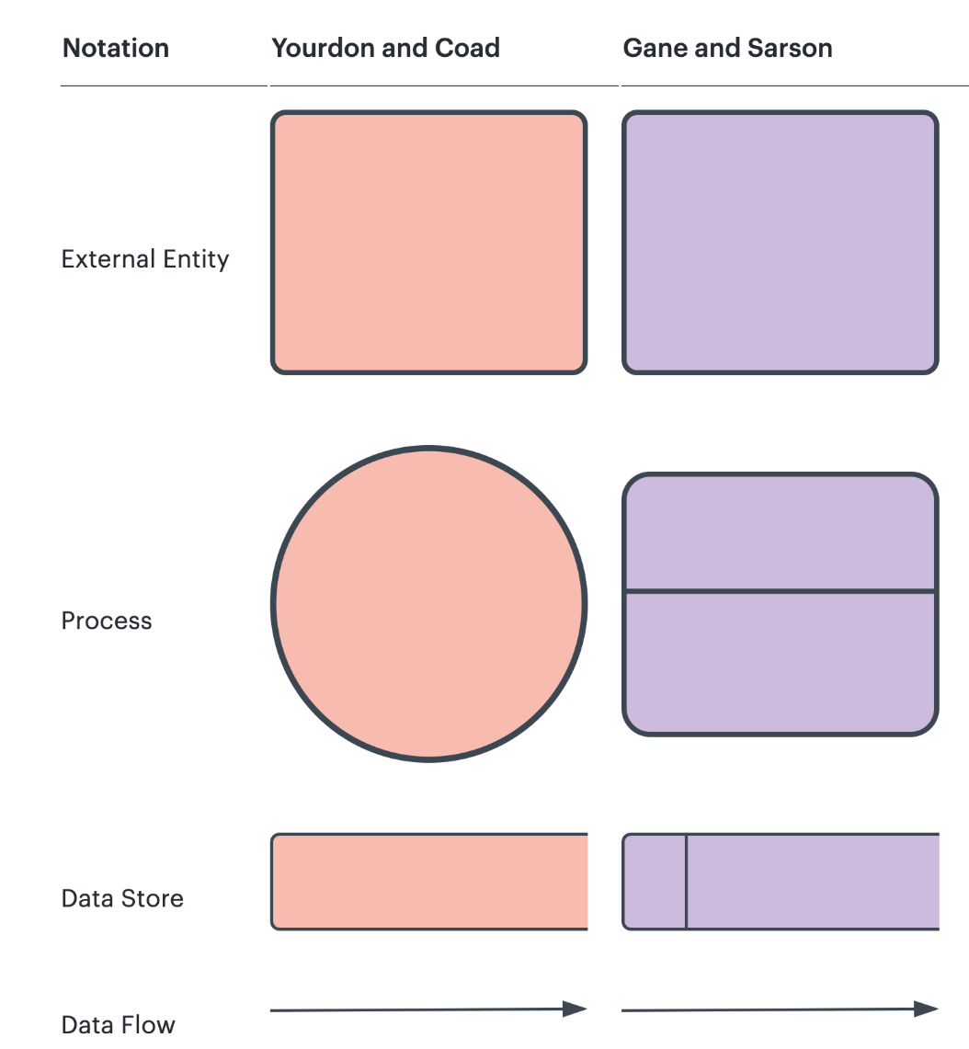
DFD Symbols and Notations
Title: Understanding DFD Symbols
HI5030 Business Systems Analysis and Design
Tutorial Week 03
Main Symbols:
External Entity: Represents sources or destinations of data.
Process: Denotes activities that transform data.
Data Store: A place where data is held.
Data Flow: Arrows indicating the flow of data between elements.
Notations:
Yourdon-Coad: Simple, rounded symbols for processes and data stores.
Gane-Sarson: Rectangular, more detailed symbols for the same elements.
08

Slide 25
HI5030 Business Systems Analysis and Design
Tutorial Week 04
DFD Levels and Layers
Title: Exploring DFD Levels
Content:
DFD Levels:
Context Diagrams (Level 0): The highest-level DFD, showing the system as a single process and its interaction with external entities.
Level 1 and Beyond: Breaks down the main process into subprocesses, offering more detail with each level.
Detailing: As levels increase, more granular information is revealed, helping to understand the system's inner workings.
Visual Examples: (images showing a Context Diagram and a Level 0 diagram).
08

Slide 26
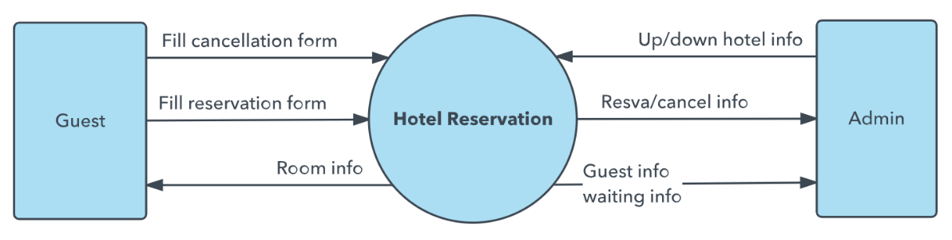
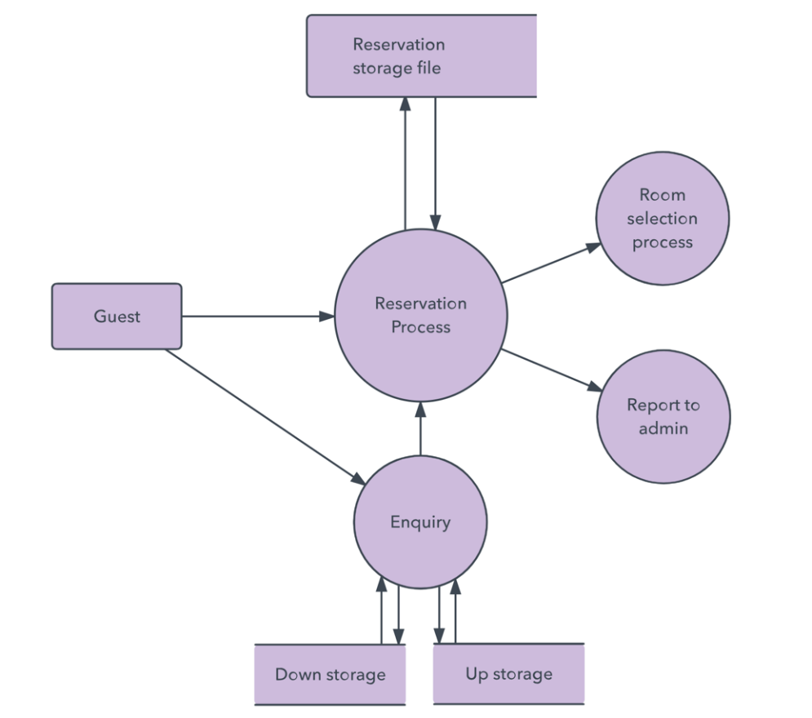
HI5030 Business Systems Analysis and Design
Tutorial Week 03
Example of a DFD – Hotel Reservation System
Title: DFD Example: Hotel Reservation System
Content:
Walkthrough:
External Entities: The Guest interacts with the system, making inquiries and reservations. (Admin is implied through the "Report to admin" process.)
Processes: The main process is the "Reservation Process," which manages booking, updates, and cancellations. There’s also an "Enquiry" process that handles initial guest inquiries.
Data Flows: Arrows show how information flows between the Guest, the Reservation Process, and various data stores like "Reservation storage file," "Down storage," and "Up storage." The "Room selection process" and "Report to admin" are also linked to the main process.
Overview: This DFD provides a clear visual of how data moves within the hotel reservation system, making it easy to understand the system’s workflow.
08

Slide 27
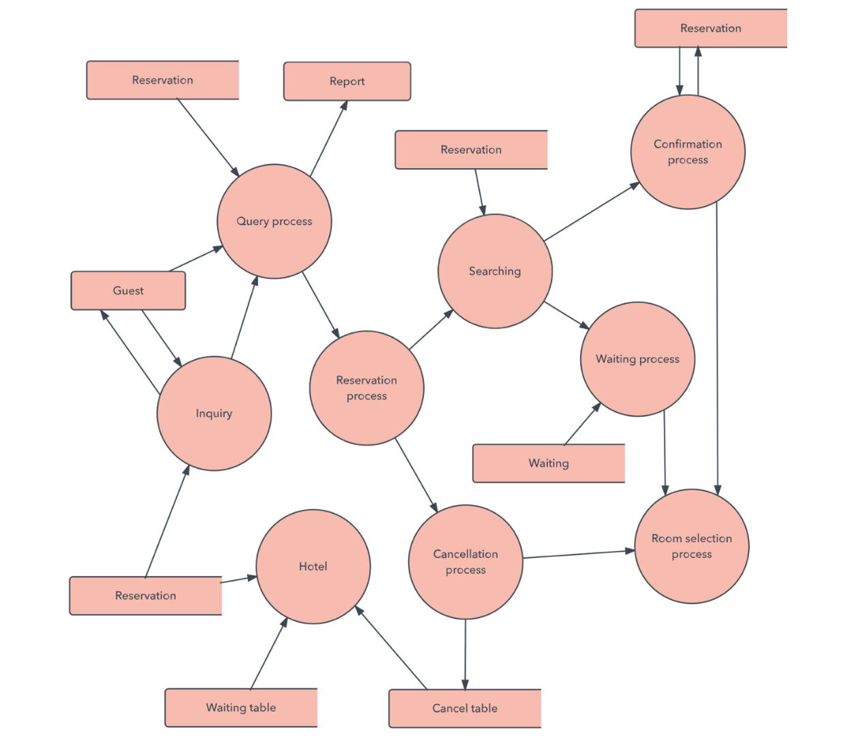
Example of a DFD – Hotel Reservation System
Title: DFD Example: Hotel Reservation System
Content:
Walkthrough:
External Entities: The Guest interacts with the system by making inquiries and reservations. Although not explicitly shown, Admin roles could be inferred through processes such as reporting.
Processes: The main process is the "Reservation process," which manages bookings, cancellations, and inquiries. Other processes include "Cancellation process," "Query process," "Confirmation process," and "Room selection process."
Data Flows: Arrows represent the movement of data between entities and processes, such as reservation details being passed from the Guest to the Reservation process, and then to storage or other processes like room selection or cancellation.

Slide 28

Overview: The DFD provides a clear visualization of how data flows within the hotel reservation system, helping to understand how different components interact and how information is processed and managed across the system.

Slide 29
HI5030 Business Systems Analysis and Design
Tutorial Week 04
DFD Example – Detailed Level
Title: DFD Example: Reservation Process (Level 1)
Content:
Detailed DFD: This slide presents a more detailed view of the Reservation process, showing how the overall system is broken down into specific subprocesses.
Subprocesses:
Enquiry: Handles guest inquiries and directs data to appropriate areas.
Room Selection Process: Manages the selection of available rooms, connecting directly to data stores that track room availability.
Confirmation Process: Finalizes reservations by confirming details and updating relevant data stores.
Connections to Data Stores: Each subprocess interacts with various data stores, ensuring that information is accurately recorded and accessible when needed.
Understanding Specific Functions: This detailed level of DFD helps in understanding how individual components operate within the system, providing clarity on how specific tasks are performed and how data flows through each stage of the reservation process.
08

Slide 30
HI5030 Business Systems Analysis and Design
Tutorial Week 04
Logical vs. Physical DFDs
Title: Logical vs. Physical DFDs
Content:
Definitions:
Logical DFDs: Focus on what the system must do, representing business activities and processes without considering how they will be implemented. These diagrams show the flow of information within a system at a conceptual level, focusing on the what.
Physical DFDs: Focus on how the system is implemented, including hardware, software, files, and people involved. These diagrams detail the actual devices, programs, and manual procedures, focusing on the how.
When to Use Each:
Logical DFDs: Best used during the early stages of system design to understand the requirements and processes. Example: mapping out the steps in a customer order process without specifying the software or hardware used.
Physical DFDs: Used in later stages of system design when determining how the system will be built. Example: detailing how a customer order is processed through specific software, databases, and hardware.
08

Slide 31
HI5030 Business Systems Analysis and Design
Tutorial Week 04
Best Practices and Rules for Creating DFDs
Title: Best Practices for Creating DFDs
Content:
Key Rules and Tips:
Ensure Inputs and Outputs: Each process in your DFD must have at least one input and one output to represent the flow of data accurately.
Connect Data Stores to Processes: Data stores should always be connected to processes, not directly to other data stores or external entities, to maintain logical flow.
Avoid Crossing Data Flows: Keep your DFD clear and easy to read by avoiding crossing data flow lines. If necessary, rearrange elements to minimize intersections.
Consistency in Symbols and Notations: Use consistent symbols and notations throughout your DFD to avoid confusion. Stick to standardized symbols like circles for processes, rectangles for data stores, and arrows for data flows.
08

Slide 32
HI5030 Business Systems Analysis and Design
Tutorial Week 04
Hands-On Exercise
Title: Exercise: Create Your Own DFD
Content:
Assignment:
Develop DFDs for the provided case studies: Video-Rental LTD and Estate Agency.
Tools:
Use tools like Lucid Charts, Io.draw, or Visual Paradigm Community Edition to create your diagrams.
Case Studies Overview:
Video-Rental LTD: Focus on mapping out the processes for customer registration, video rentals, returns, and inventory management.
Estate Agency: Create DFDs covering processes such as property listings, client inquiries, viewings, and sales transactions.
DFD Coverage:
Ensure your DFDs include all key processes, data stores, external entities, and data flows relevant to the business operations described in the case studies.
08

Slide 33
HI5030 Business Systems Analysis and Design
Tutorial Week 04
A couple of short-video resources to help you create Data Flow Diagrams (DFDs):
EASY-HOW-TO Data Flow Diagram (DFD) Tutorial - This video provides a straightforward tutorial on how to create a DFD, covering the basics and making it accessible for beginners.
How to Draw a Data Flow Diagram - This video walks through the steps to draw a DFD, explaining each part of the process and offering practical tips.
Data Flow Diagram EXAMPLE - This video gives an example of how to create a DFD, which can be helpful for visual learners who want to see the process in action.
These resources should help you get a clear understanding of how to approach your DFD assignments for the Video-Rental LTD and Estate Agency case studies.
08

Slide 34
HI5030 Business Systems Analysis and Design
Tutorial Week 04
Title: Summary and Questions
Content:
Recap of Key Points:
What a DFD Is: A Data Flow Diagram (DFD) is a visual representation that illustrates how data moves through a system, highlighting the processes, data stores, external entities, and data flows.
Symbols and Notations: We discussed the key symbols (e.g., process, data store, external entity, data flow) and the differences between common notations like Yourdon-Coad and Gane-Sarson.
Levels and Layers: DFDs can range from high-level overviews (Context Diagrams/Level 0) to more detailed breakdowns (Level 1 and beyond), each providing a deeper understanding of system components.
Practical Applications: DFDs are widely used in both business analysis and software engineering to map out and optimize systems, making complex processes easier to understand and implement.
08

Slide 35
HI5030 Business Systems Analysis and Design
Tutorial Week 04
Q&A:
Please reach out for any questions to clarify concepts or address any uncertainties.
Conclusion:
This step-by-step guide is designed to help you understand DFDs effectively by focusing on the most crucial aspects of the concept. Using visual aids and hands-on exercises reinforces learning, making the topic more accessible and engaging for you. The images provided serve as excellent examples to differentiate notations and levels, ensuring you grasp the material effectively.
This summary should help wrap up the lesson and provide you with a comprehensive understanding of DFDs, along with an opportunity to ask questions and solidify your knowledge.
08

Slide 36
Creating Data Flow Diagrams
Lemonade Stand Example

Slide 37
Creating Data Flow Diagrams
Example
Steps:
The operations of a simple lemonade stand will be used to demonstrate the creation of dataflow diagrams.
Create a list of activities
Old way: no Use-Case Diagram
New way: use Use-Case Diagram
Construct Context Level DFD (identifies sources and sink)
Construct Level 0 DFD (identifies manageable sub processes )
Construct Level 1- n DFD (identifies actual data flows and data stores )

Slide 38
Creating Data Flow Diagrams
Example
Create a list of activities
Think through the activities that take place at a lemonade stand.
Customer Order
Serve Product
Collect Payment
Produce Product
Store Product

Slide 39
Creating Data Flow Diagrams
Example
Create a list of activities
Also think of the additional activities needed to support the basic activities.
Customer Order
Serve Product
Collect Payment
Produce Product
Store Product
Order Raw Materials
Pay for Raw Materials
Pay for Labor

Slide 40
Creating Data Flow Diagrams
Example
Create a list of activities
Group these activities in some logical fashion, possibly functional areas.
Customer Order
Serve Product
Collect Payment
Produce Product
Store Product
Order Raw Materials
Pay for Raw Materials
Pay for Labor

Slide 41
Creating Data Flow Diagrams
Example
Construct Context Level DFD (identifies sources and sink)
Create a context level diagram identifying the sources and sinks (users).
Context Level DFD
CUSTOMER
Order
0.0
Lemonade System
Sales Forecast
EMPLOYEE
Customer Order
Serve Product
Collect Payment
Produce Product
Store Product
Order Raw Materials
Pay for Raw Materials
Pay for Labor
Product Served
Production Schedule
Payment
Pay
Received Goods
Time Worked
Payment
Purchase Order
VENDOR

Slide 42
Creating Data Flow Diagrams
Example
Construct Level 0 DFD (identifies manageable sub processes )
Create a level 0 diagram identifying the logical subsystems that may exist.
Level 0 DFD
1.0
Sale
Customer Order
Serve Product
Collect Payment
Produce Product
Store Product
Order Raw Materials
Pay for Raw Materials
Pay for Labor
Customer Order
Sales Forecast
Product Ordered
CUSTOMER
Payment
2.0
Production
EMPLOYEE
Product Served
Production Schedule
VENDOR
Received Goods
3.0
Procure-ment
Inventory
Purchase Order
Order Decisions
Payment
Pay
Time Worked
4.0
Payroll

Slide 43

Creating Data Flow Diagrams
Example
Construct Level 1- n DFD (identifies actual data flows and data stores )
Create a level 1 decomposing the processes in level 0 and identifying data stores.
Level 1 DFD
CUSTOMER
Customer Order
Request for Forecast
Customer Order
Serve Product
Collect Payment
Produce Product
Store Product
Order Raw Materials
Pay for Raw Materials
Pay for Labor
1.1
Record Order
ORDER
1.3
Produce Sales Forecast
Severed Order
Payment
Sales Forecast
1.2
Receive Payment
PAYMENT

Slide 44
Creating Data Flow Diagrams
Example
Construct Level 1 (continued)
Create a level 1 decomposing the processes in level 0 and identifying data stores.
Level 1 DFD
Product Order
Customer Order
Serve Product
Collect Payment
Produce Product
Store Product
Order Raw Materials
Pay for Raw Materials
Pay for Labor
2.1
Serve Product
ORDER
Quantity Severed
Production Schedule
RAW MATERIALS
2.2
Produce Product
Quantity Used
Production Data
INVENTORTY
2.3
Store
Product
Quantity Produced & Location Stored

Slide 45
Creating Data Flow Diagrams
Example
Construct Level 1 (continued)
Create a level 1 decomposing the processes in level 0 and identifying data stores.
Level 1 DFD
Order Decision
3.1
Produce Purchase Order
PURCHASE ORDER
Customer Order
Serve Product
Collect Payment
Produce Product
Store Product
Order Raw Materials
Pay for Raw Materials
Pay for Labor
Quantity On-Hand
Quantity Received
RAW MATERIALS
Received Goods
3.2
Receive Items
RECEIVED ITEMS
Payment Approval
3.3
Pay Vendor
VENDOR
Payment

Slide 46
Creating Data Flow Diagrams
Example
Construct Level 1 (continued)
Create a level 1 decomposing the processes in level 0 and identifying data stores.
Level 1 DFD
Time Worked
4.1
Record Time Worked
TIME CARDS
Customer Order
Serve Product
Collect Payment
Produce Product
Store Product
Order Raw Materials
Pay for Raw Materials
Pay for Labor
Employee ID
EMPLOYEE
Payroll Request
4.2
Calculate Payroll
Unpaid time cards
PAYROLL
Payment Approval
4.3
Pay Employee
PAYMENTS
Payment

Slide 47
Process Decomposition
1.0
Sale
1.1
Record Order
1.2
Receive Payment
2.0
Production
2.1
Serve Product
2.2
Produce Product
2.3
Store
Product
0.0
Lemonade System
3.0
Procure-ment
3.1
Produce Purchase Order
3.2
Receive Items
3.3
Pay Vendor
4.0
Payroll
4.1
Record Time Worked
4.2
Calculate Payroll
4.3
Pay Employee
Context Level
Level 0
Level 1

Slide 48
DFD Example: Bus Garage Repairs
Buses come to a garage for repairs.
A mechanic and helper perform the repair, record the reason for the repair and record the total cost of all parts used on a Shop Repair Order.
Information on labor, parts and repair outcome is used for billing by the Accounting Department, parts monitoring by the inventory management computer system and a performance review by the supervisor.

Slide 49
DFD Example: Bus Garage Repairs (cont’d)
External Entities: Bus, Mechanic, Helper, Supervisor, Inventory Management System, Accounting Department, etc.
Key process (“the system”): performing repairs and storing information related to repairs
Processes:
Record Bus ID and reason for repair
Determine parts needed
Perform repair
Calculate parts extended and total cost
Record labor hours, cost

Slide 50
DFD Example: Bus Garage Repairs (cont’d)
Data stores:
Personnel file
Repairs file
Bus master list
Parts list
Data flows:
Repair order
Bus record
Parts record
Employee timecard
Invoices

Slide 51
Bus Garage Context Diagram
Bus
Mechanical problem
to be repaired
Fixed mechanical
problems
Helper
Bus Repair Process
System
Repair summary
Supervisor
Labor
List of parts used
Inventory Management System
Labor
Labor, parts cost details
Mechanic
Accounting

Slide 52
CSUB Burger’s Order Processing System
Draw the CSUB Burger’s context diagram
System
Order processing system
External entities
Kitchen
Restaurant
Customer
Processes
Customer order
Receipt
Food order
Management report

